Slide 1

HOSPITAL MANAGEMENT SYSTEM

Slide 2
TEAM MEMBERS
Samarpanrao Pedapudi (EMPID:6572)
Junaid Ahmed Baig (EMPID:6576)
Aligeti Sai Kiran Reddy (EMPID:6568)
Konchada Sai Harini (EMPID:6566)
Shameer Sharif Shaik (EMPID:6578)

Slide 3
INDEX
INTRODUCTION
TEAM MEMBERS
PROBLEM STATEMENT
SCREENSHOTS
ARCHITECTURE
TECHNOLOGIES USED

Slide 4
INTRODUCTION
The Hospital Management System can handle all the details about a Hospital.
The details include Doctor details, Patient details, Appointment details, etc.
The Hospital Management System is an automated version of manual Hospital Management System.

Slide 5
PROBLEM STATEMENT
Hospital Management system is an integrated platform that connects patients with specialized practitioners which enable tele-consulting services integrating doctor, patients and to monitor the health of patients.
This web application should be built in such a way that it can be integrated with multiple hospitals, health care providers.
It includes capturing prescription details and previous records and sending automated reminders. It is designed to track the status of the action items in the subsequent meeting.
It can be done through registering into the site and logging in it gives the required information.

Slide 6
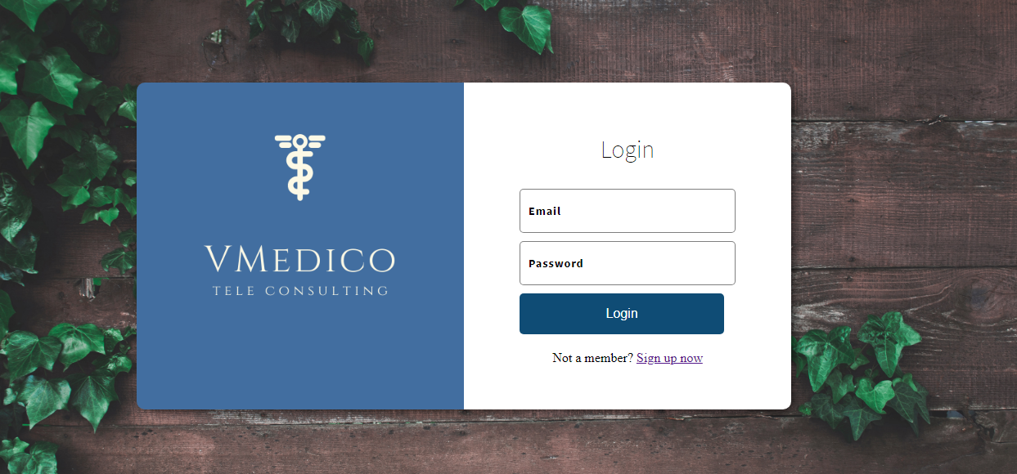
HOME PAGE

Slide 7


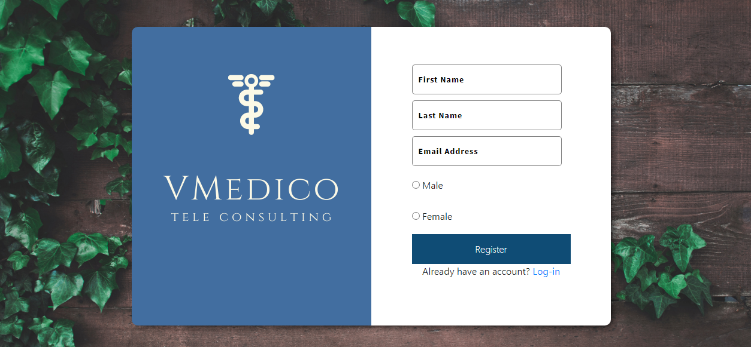

REGISTRATION & LOGIN
Signing up in the registration form which is having validations
Logging in with the credentials created during registration.

Slide 8
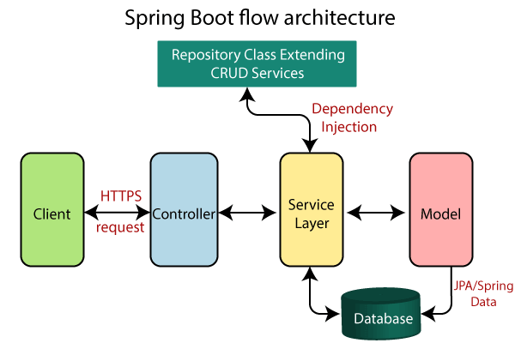
ARCHITECTURE

Slide 9




TECHNOLOGIES USED

